Slide 1
Employee Data Analysis using Excel
STUDENT NAME: K.SOWMIYA
REGISTER NO: 2213391036047
DEPARTMENT: COMMERCE
COLLEGE : QUEEN MARY'S COLLEGE

Slide 2
PROJECT TITLE
EMPLOYEES TRAINING
DATABASE

Slide 3


AGENDA
Problem Statement
Project Overview
End Users
Our Solution and Proposition
Dataset Description
Modelling Approach
Results and Discussion
Conclusion
3/21/2024 Annual Review

Slide 4

PROBLEM STATEMENT
- Title: Inefficient Employee Training Management - Bullet points: - Difficulty in tracking employee training records - Inadequate visibility into training effectiveness - Limited insights for informed decision-making - Inefficient use of training resources

Slide 5

PROJECT OVERVIEW
- Title: Employees Training Database Project - Bullet points: - Develop a centralized database for employee training records - Design a user-friendly interface for easy data entry and retrieval - Implement data analytics for insights and reporting - Enhance employee development and training effectiveness
.

Slide 6

WHO ARE THE END USERS?
- Title: Who Will Benefit from the Database? - Bullet points: - HR Department - Training Managers - Employees - Supervisors and Managers

Slide 7

OUR SOLUTION AND ITS VALUE PROPOSITION
- Title: A Comprehensive Employee Training Database - Bullet points: - Centralized repository for training records - Automated tracking and reporting - Data-driven insights for informed decision-making - Enhanced employee development and engagement

Slide 8
Dataset Description
- Title: Training Data Overview - Bullet points: - Employee demographic data (ID, Name, Department, Designation) - Training data (Training Date, Days, Skills to Upgrade, Type, Score, Location)

Slide 9

THE "WOW" IN OUR SOLUTION
- Title: What Sets Our Solution Apart? - Bullet points: - User-friendly interface for easy data entry and retrieval - Automated tracking and reporting for real-time insights - Personalized development plans for enhanced employee engagement - Data-driven decision-making for optimized training resources
3/21/2024 Annual Review
9

Slide 10
MODELLING
- Title: Data Analytics and Modelling - Bullet points: - Descriptive analytics for data visualization - Predictive analytics for forecasting training needs - Prescriptive analytics for personalized development plans
10

Slide 11
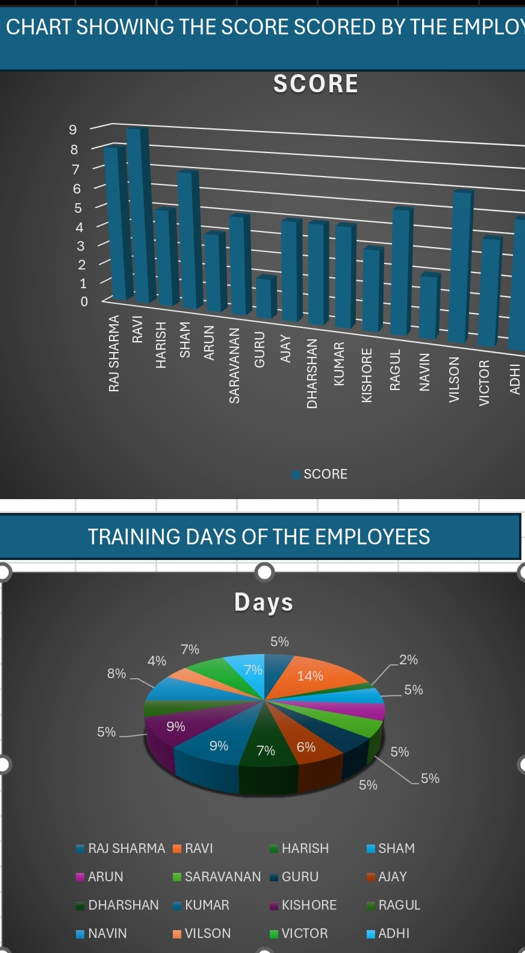
RESULTS
- Title: Insights and Outcomes - Bullet points: - Key findings from data analysis (e.g., most common skills to upgrade, training effectiveness by department) - Training effectiveness metrics (e.g., score averages, improvement over time) - Employee engagement and development outcomes (e.g., increased job satisfaction, improved performance)
11

Slide 12
conclusion
- Title: Enhancing Employee Development through Data-Driven Insights - Summary of key points - Future directions and recommendations
- Developed a centralized employee training database - Implemented data analytics for insights and reporting - Enhanced employee development and training effectiveness - Improved visibility into training records and effectiveness - Informed decision-making for HR and training managers

